Slide 1
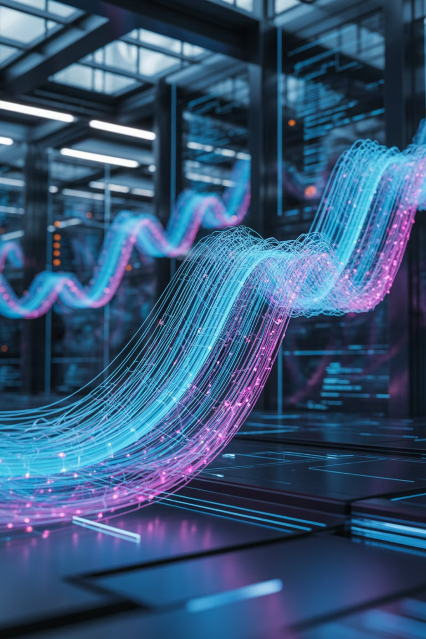
Systems Dynamics, Control and Optimization
Understanding how complex systems evolve, stabilize, and optimize over time

Slide 2
What is Systems Dynamics?
Systems dynamics studies how the state of a system changes over time under the influence of internal and external factors. It focuses on feedback, time delays, and interactions among system components.
Understand
Predict
Control
Analyze how systems behave and interact
Forecast future system states and outcomes
Regulate and optimize system performance
These principles apply across biological, ecological, industrial, and social systems.

Slide 3




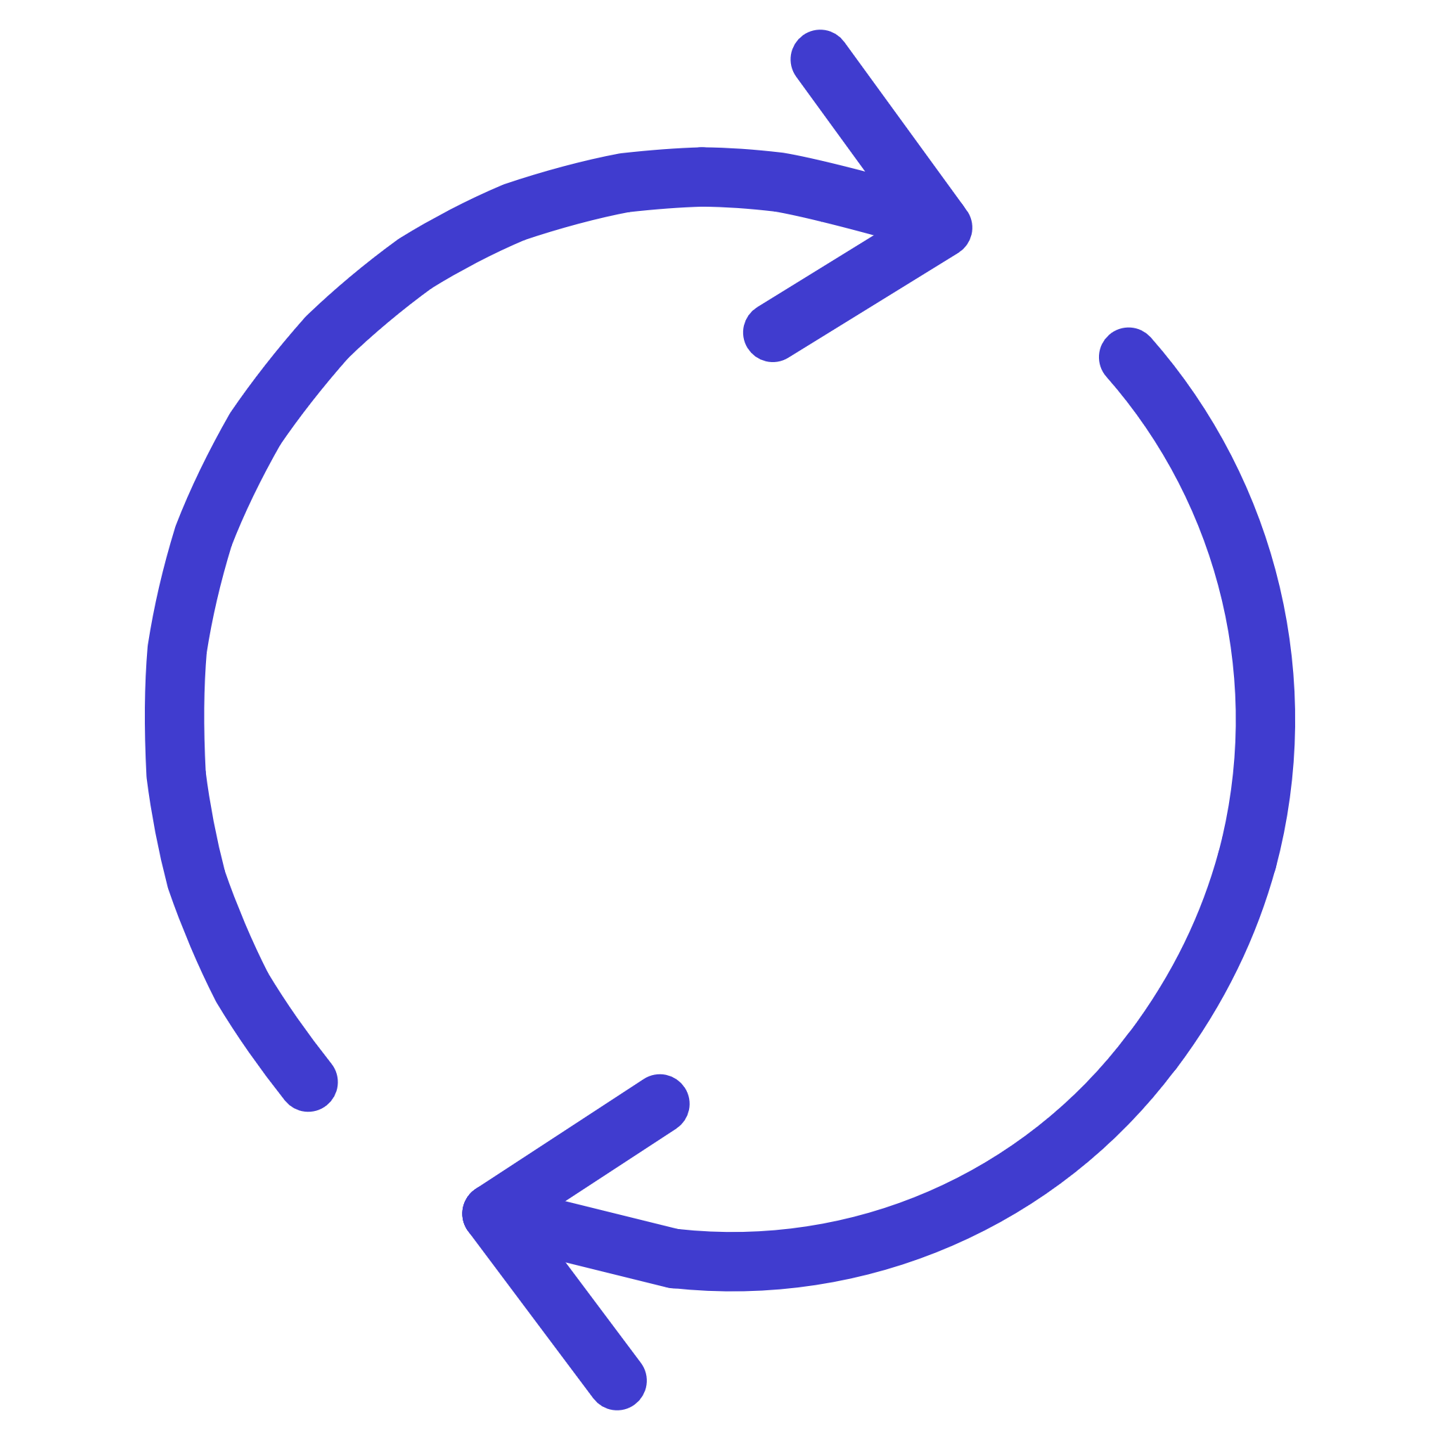
Key Components of Dynamic Systems
System
State Variables
Input
A set of interacting elements such as cell metabolism, ecosystems, or machines that work together as a unified whole.
Quantities describing the system's condition, including concentration, population, or temperature measurements.
External factors that influence the system's behavior and drive changes in state variables.
Output
Feedback
Observable results or responses that emerge from the system's processing of inputs.
Mechanism by which system output affects its own future state, creating loops of influence.

Slide 4
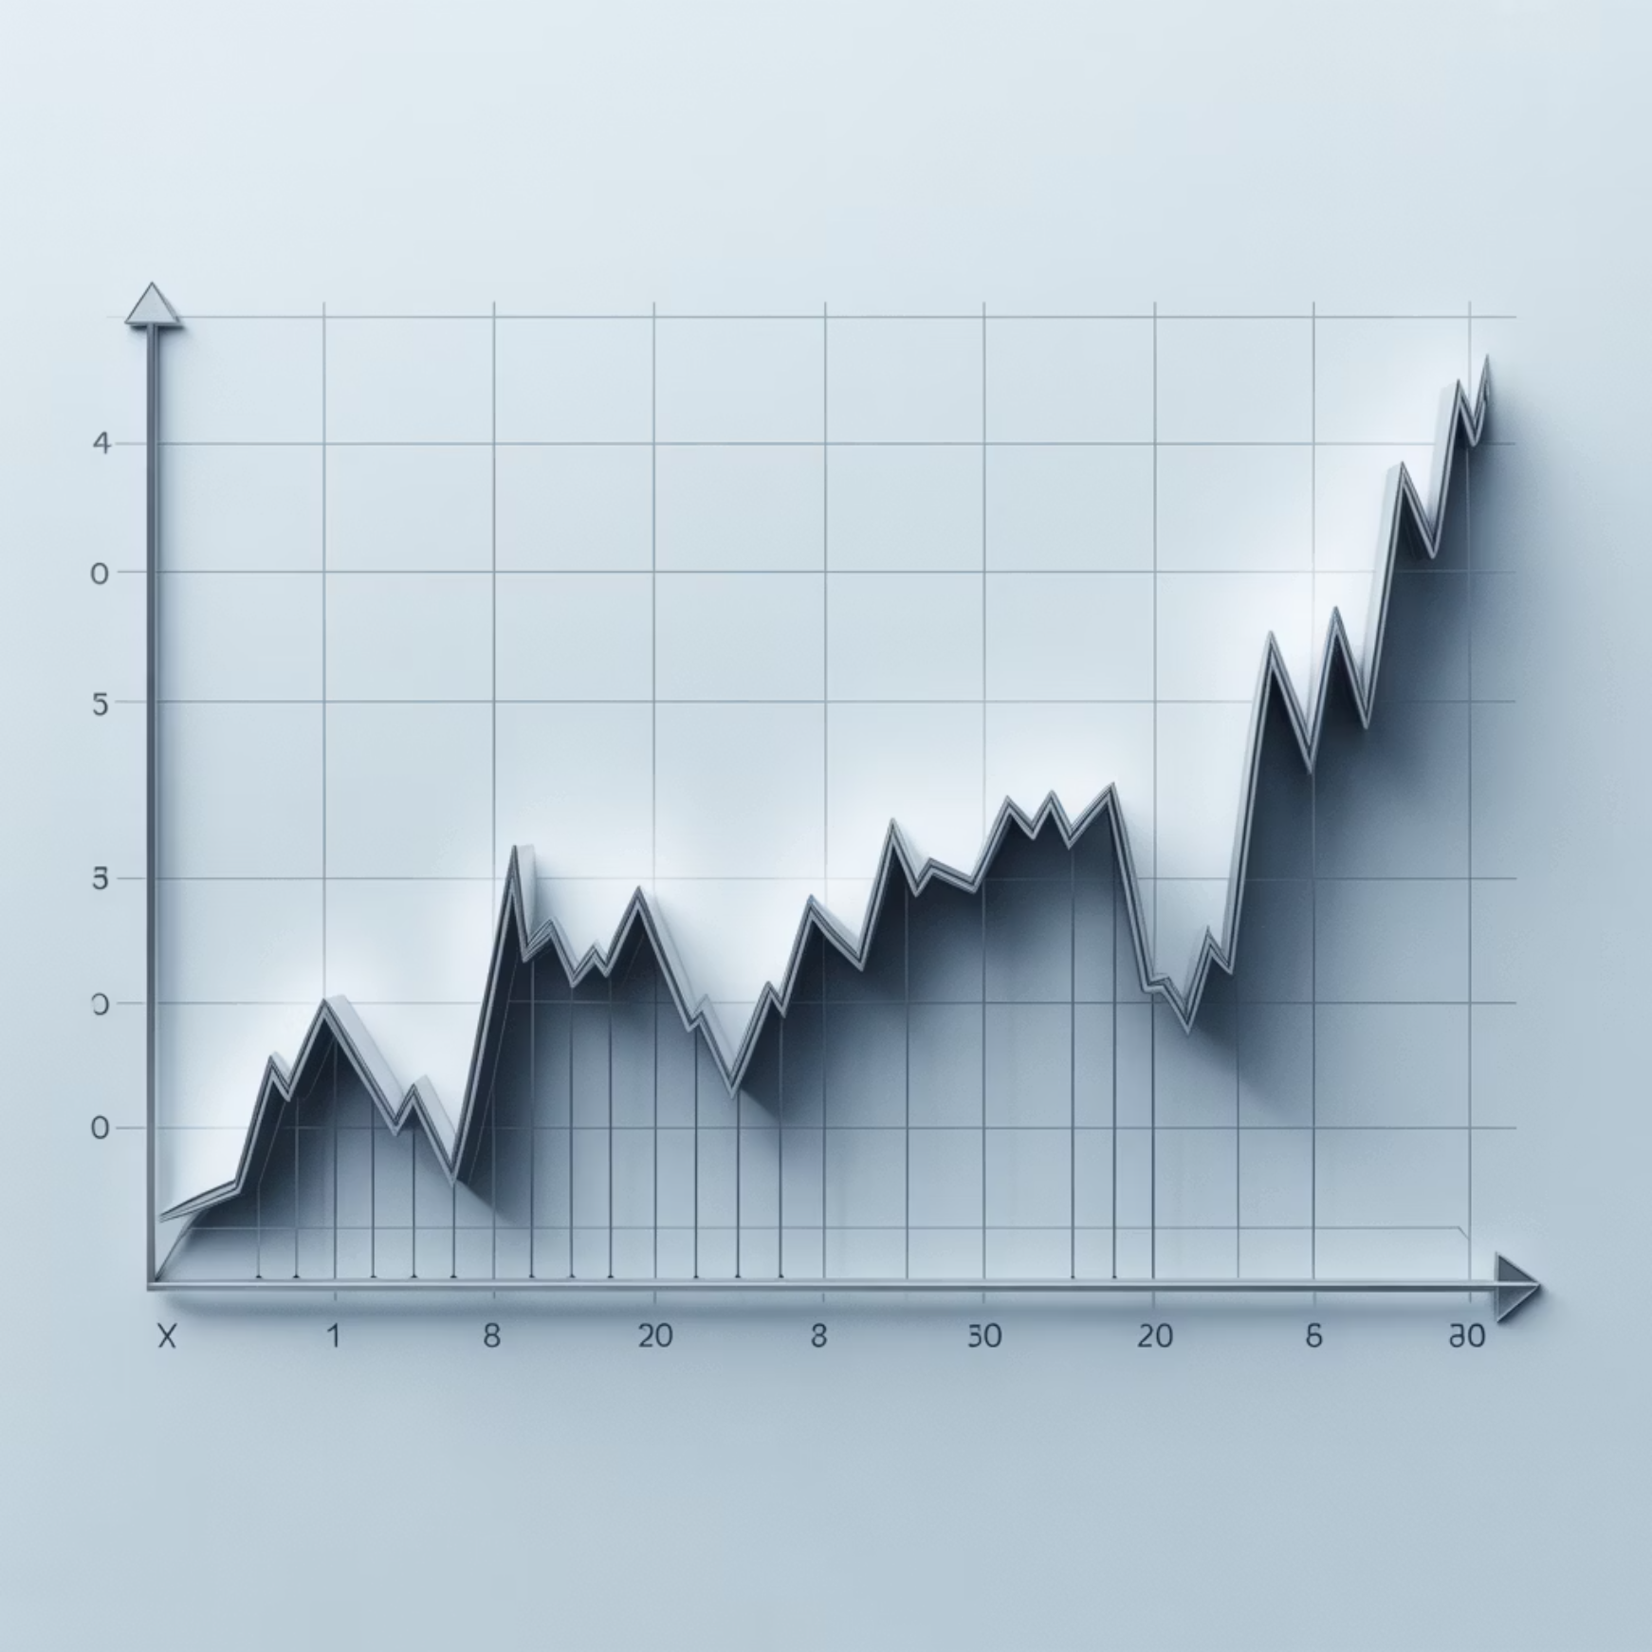
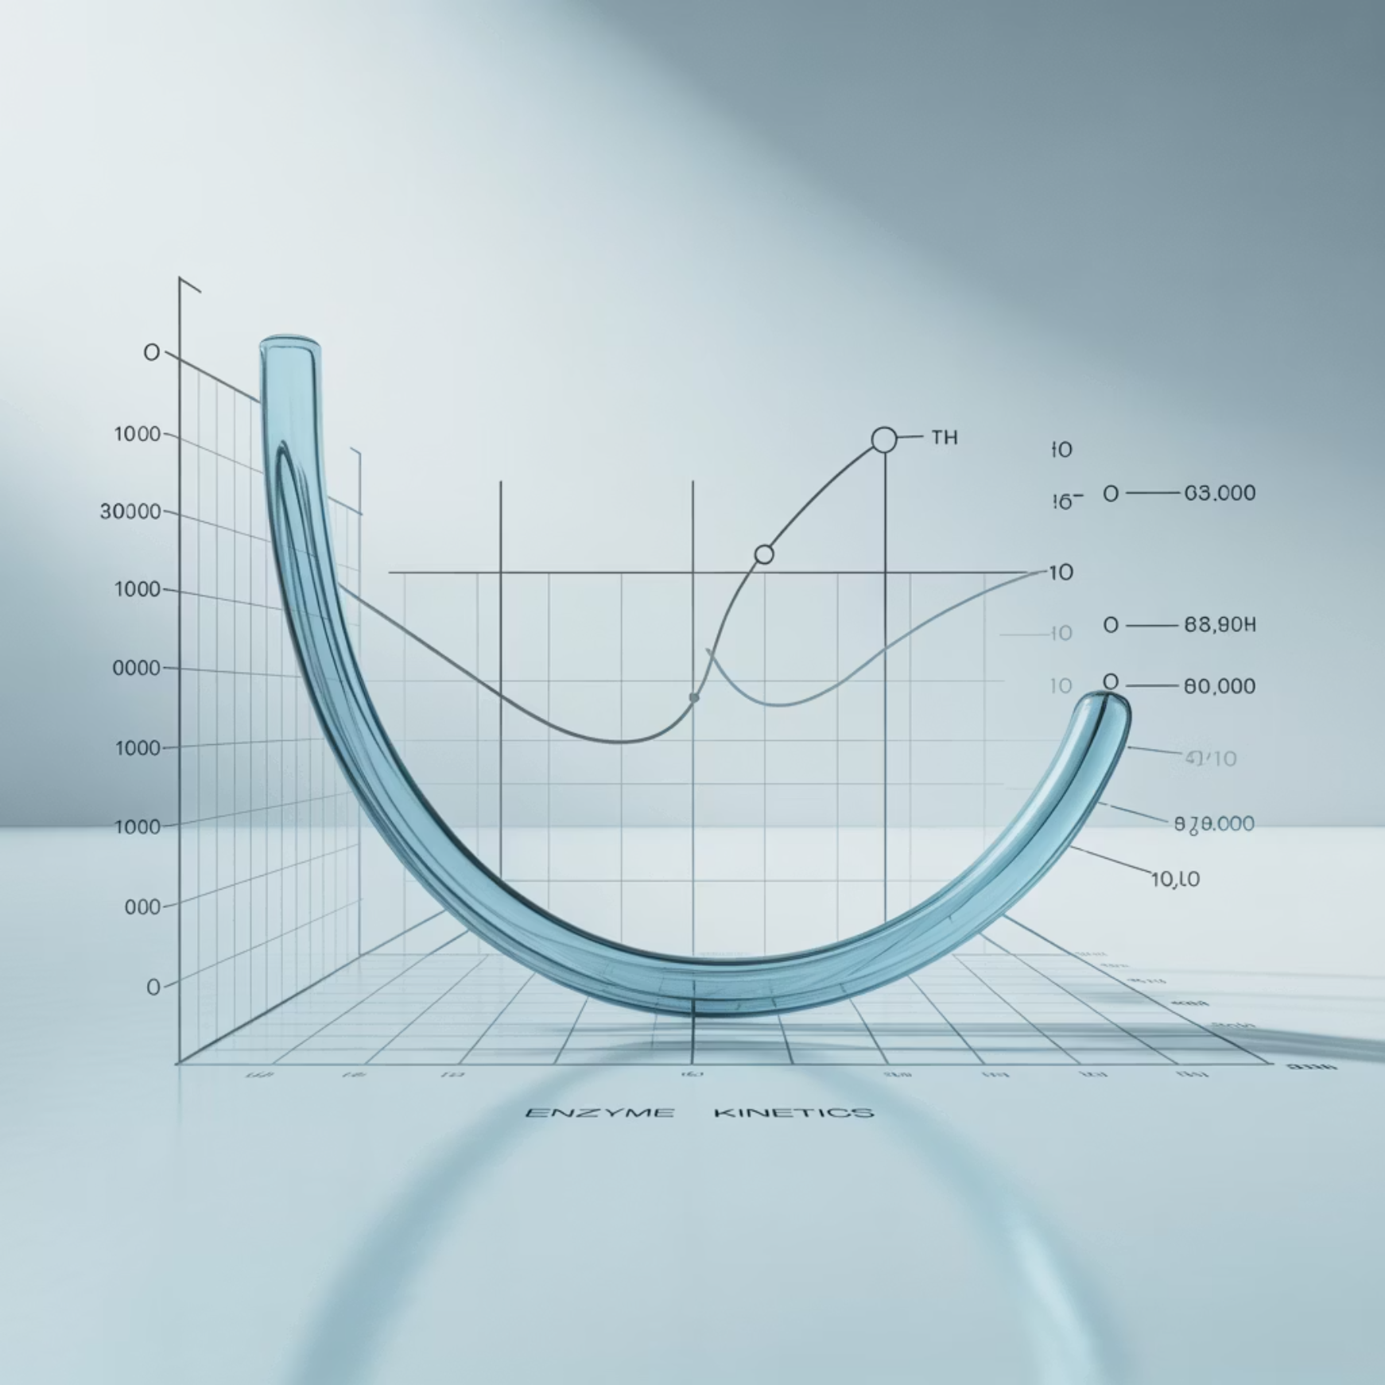
Types of Systems
Linear Systems
Non-linear Systems
Output changes proportionally with input, following predictable
mathematical relationships.
Output changes non-linearly, creating complex and often
unpredictable behaviors.
Example: Ohm's law in electricity demonstrates perfect linear behavior where voltage, current, and resistance maintain constant ratios.
Example: Enzyme kinetics following Michaelis-Menten equations show saturation effects and non-proportional responses.

Slide 5


Dynamic Behavior Patterns
1
2
Steady State
Transient State
System variables remain constant over time, achieving equilibrium where inputs equal outputs.
System variables change over time before stabilization, representing the transition period toward equilibrium.
3
4
Oscillations
Instability
Repetitive variations occur in regular patterns, such as circadian rhythms in biological systems.
Uncontrolled or diverging behavior where the system fails to maintain equilibrium or predictable patterns.

Slide 6
Feedback Mechanisms
Feedback loops are fundamental to system dynamics, determining whether systems amplify changes or maintain stability.
Positive Feedback
Enhances the change, creating self-amplifying effects that drive the system away from its initial state.
Blood clotting cascades
Chain reactions in chemical processes
Negative Feedback
Stabilizes the system by counteracting changes, maintaining homeostasis and equilibrium.
Body temperature regulation
Blood sugar regulation

Slide 7
Mathematical Representation
Differential equations describe the rate of change of system variables, providing a mathematical foundation for understanding dynamics.
where x = state variable, u = input, t = time
Example: Simple Population Model
r = growth rate
This equation shows the dynamic balance between growth and environmental limitation, demonstrating how populations stabilize.
K = carrying capacity
N = population size

Slide 8
System Representation Tools
Block Diagrams
Flow Diagrams
Simulation Tools
Visualize input-output relationships and signal flow through system components.
Show feedback loops and interactions between system elements using causal relationships.
MATLAB, Simulink, VENSIM, STELLA, and Python enable computational modeling and analysis.

Slide 9







Control Systems
A control system is designed to regulate its own output to achieve a desired goal or maintain stability through continuous monitoring and adjustment.
Controller
Compares measured value with set point
Sensor
Measures output variable
Actuator
Corrects deviation by adjusting system input
Example: Body temperature regulation uses the hypothalamus as controller, skin receptors as sensors, and sweat glands as actuators.

Slide 10

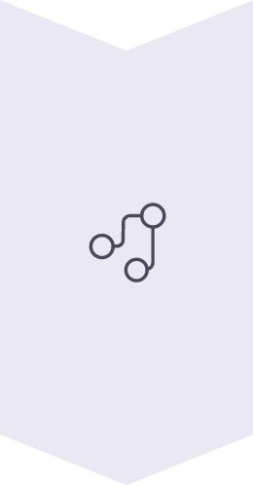
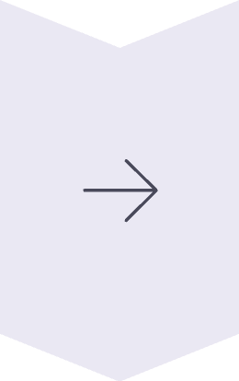
Types of Control Systems
Open-Loop Control
No feedback; system acts only on input command without monitoring results.
Example: Washing machine timer
Closed-Loop Control
Uses feedback to continuously adjust system performance based on output.
Example: Thermostat
Feed-Forward Control
Predicts disturbances and adjusts beforehand to prevent deviations.
Example: Anticipatory muscle movement

Slide 11
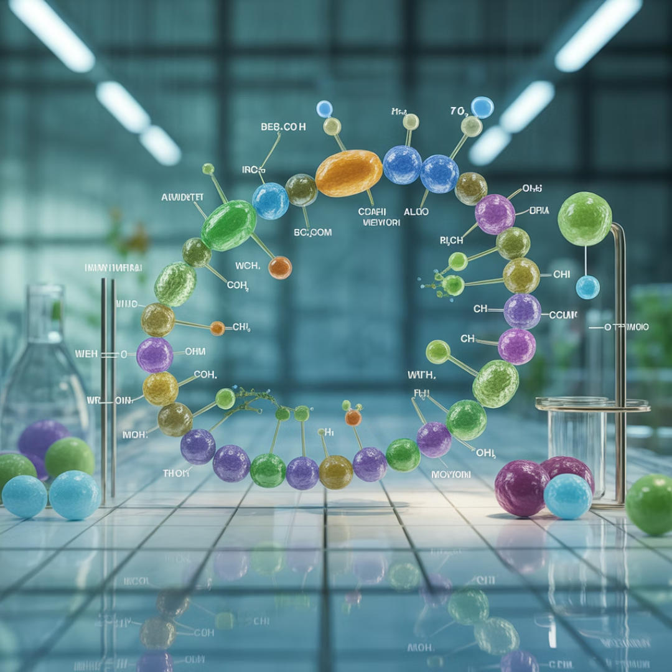
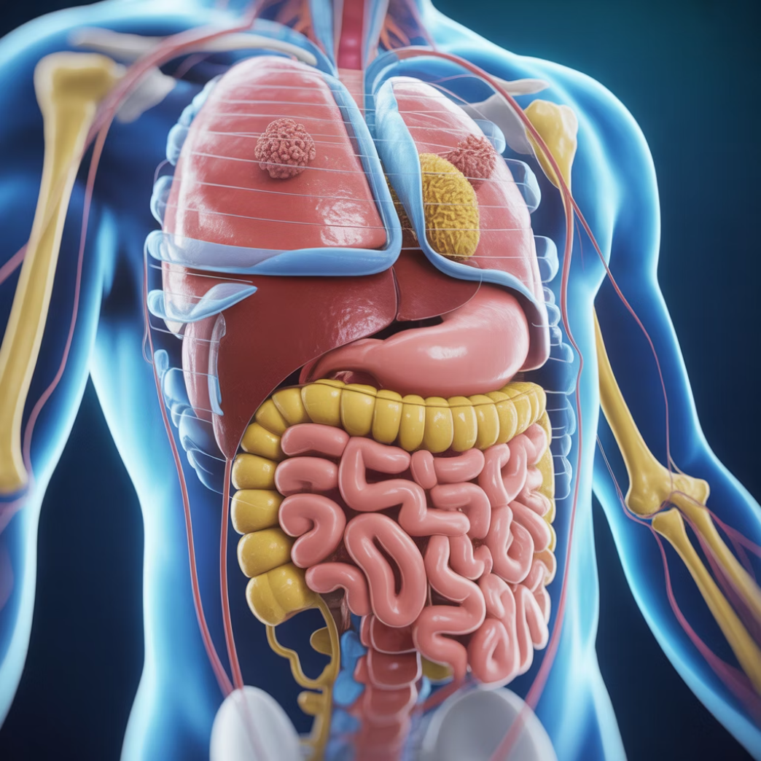
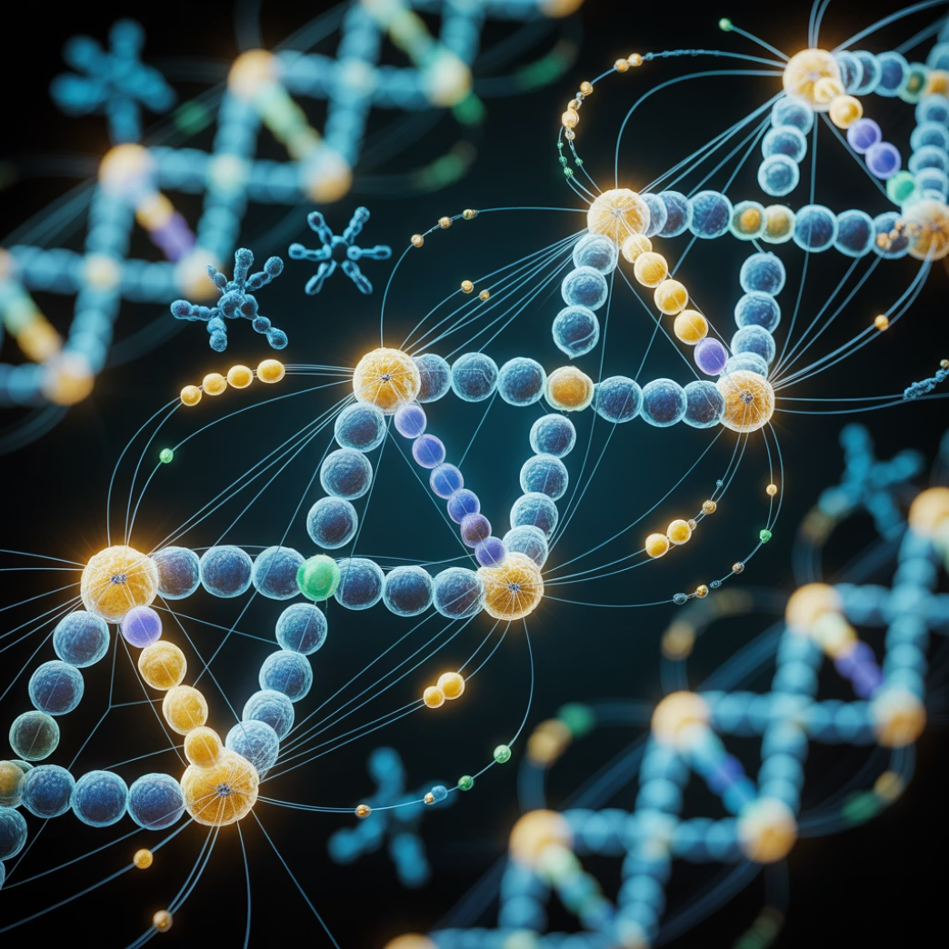
Control Theory in Biological Systems
Homeostasis
Gene Regulatory Networks
Metabolic Control Analysis
Maintaining stable internal conditions through negative feedback loops that counteract disturbances.
Control expression levels using repressors and activators in complex feedback circuits.
Quantifies how enzyme activity influences overall pathway flux and system behavior.

Slide 12






Optimization in Dynamic Systems
Optimization is the process of finding the best possible outcome—maximum efficiency, minimum cost, or optimal performance—under given constraints.
Maximize Productivity
Minimize Consumption
Achieve Stability
Enhance yield, growth rate, and output efficiency
Reduce energy and resource usage
Ensure robustness and reliable performance

Slide 13
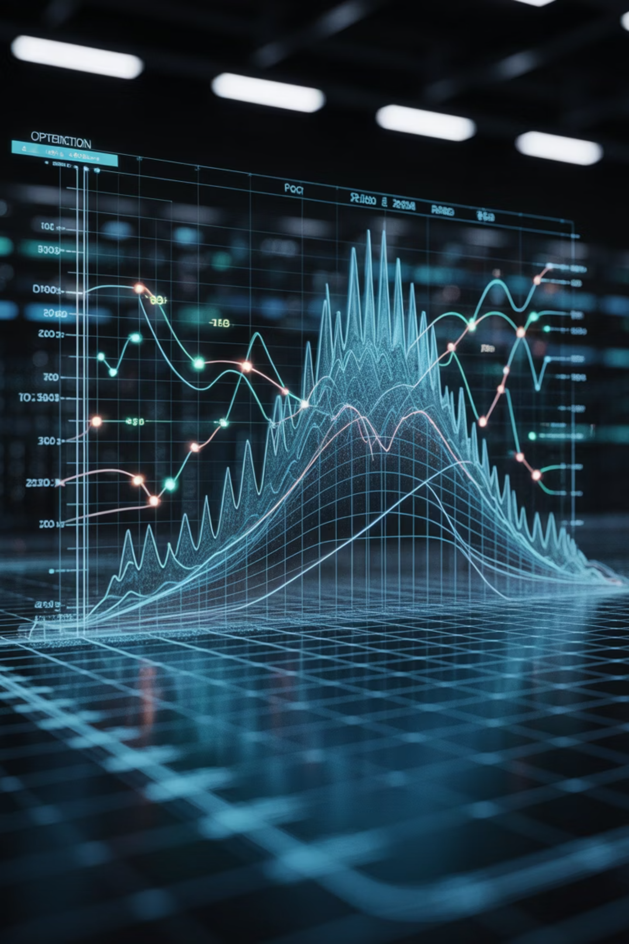
Types of Optimization
01
02
Static Optimization
Dynamic Optimization
System is at steady state—optimize enzyme levels in metabolic pathways for maximum efficiency.
System evolves over time—optimize drug dosage schedules throughout treatment periods.
03
Multi-Objective Optimization
Balances multiple conflicting goals—maximize yield while simultaneously minimizing production costs.

Slide 14

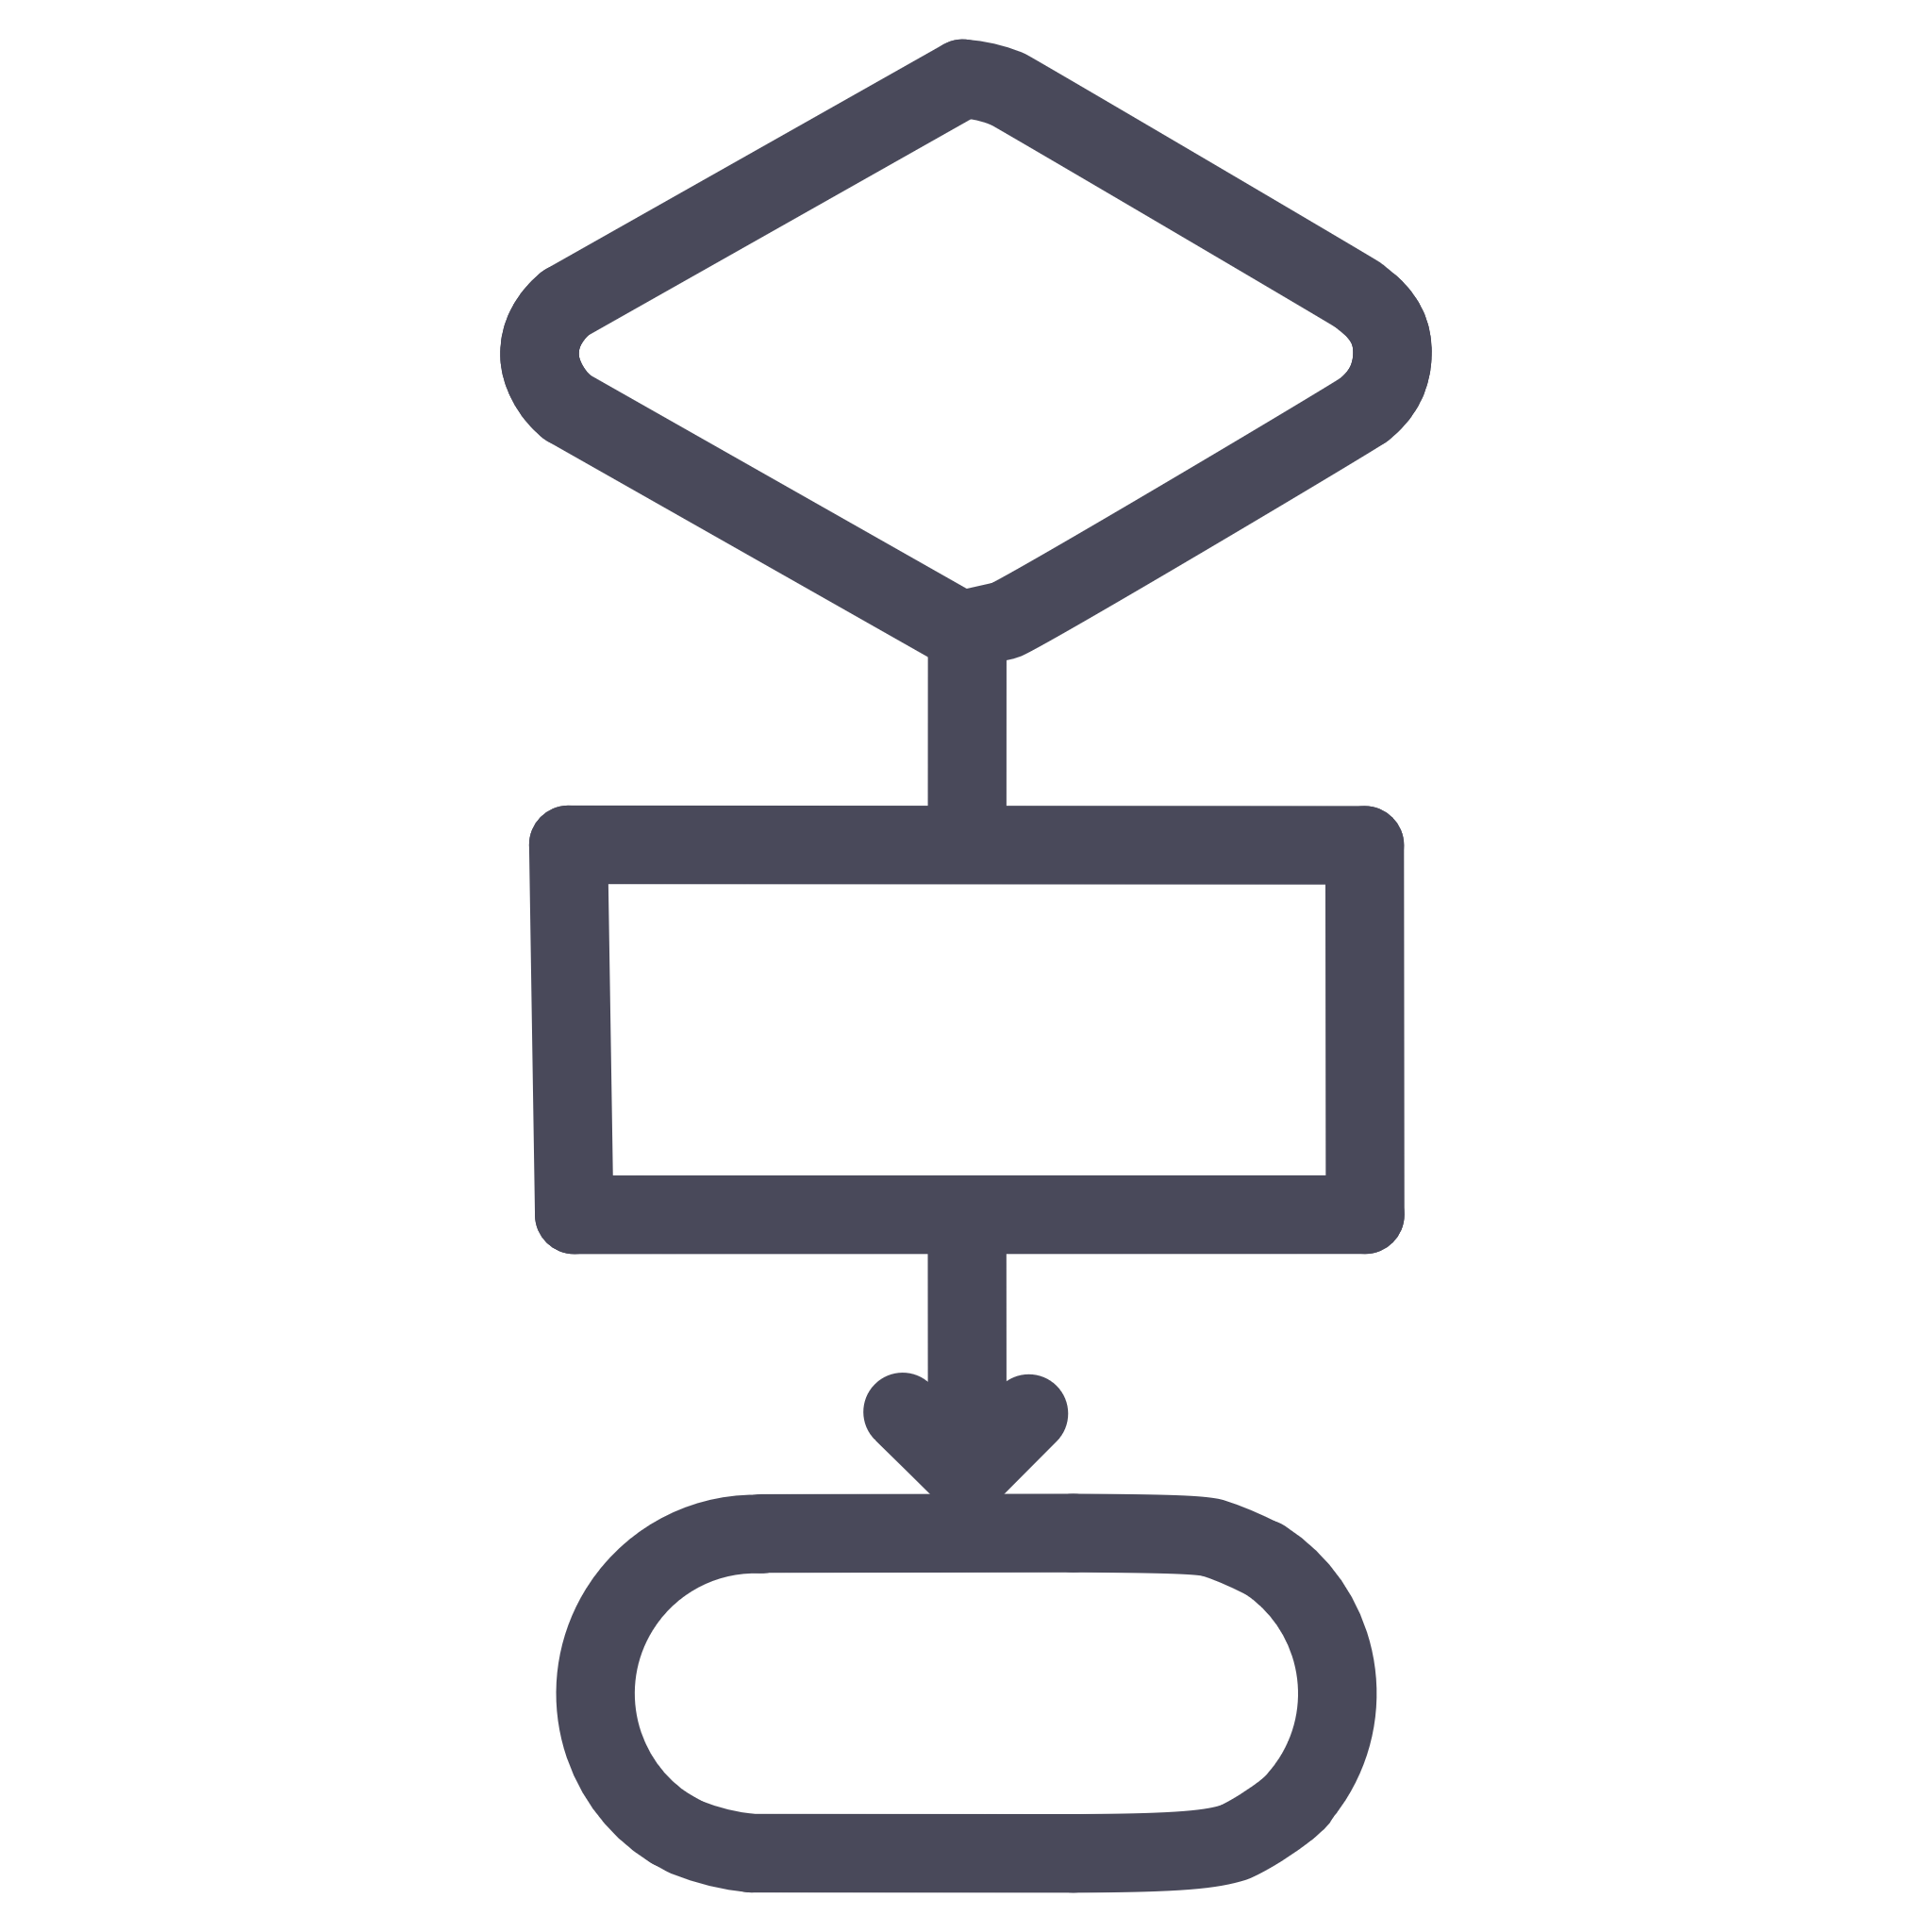
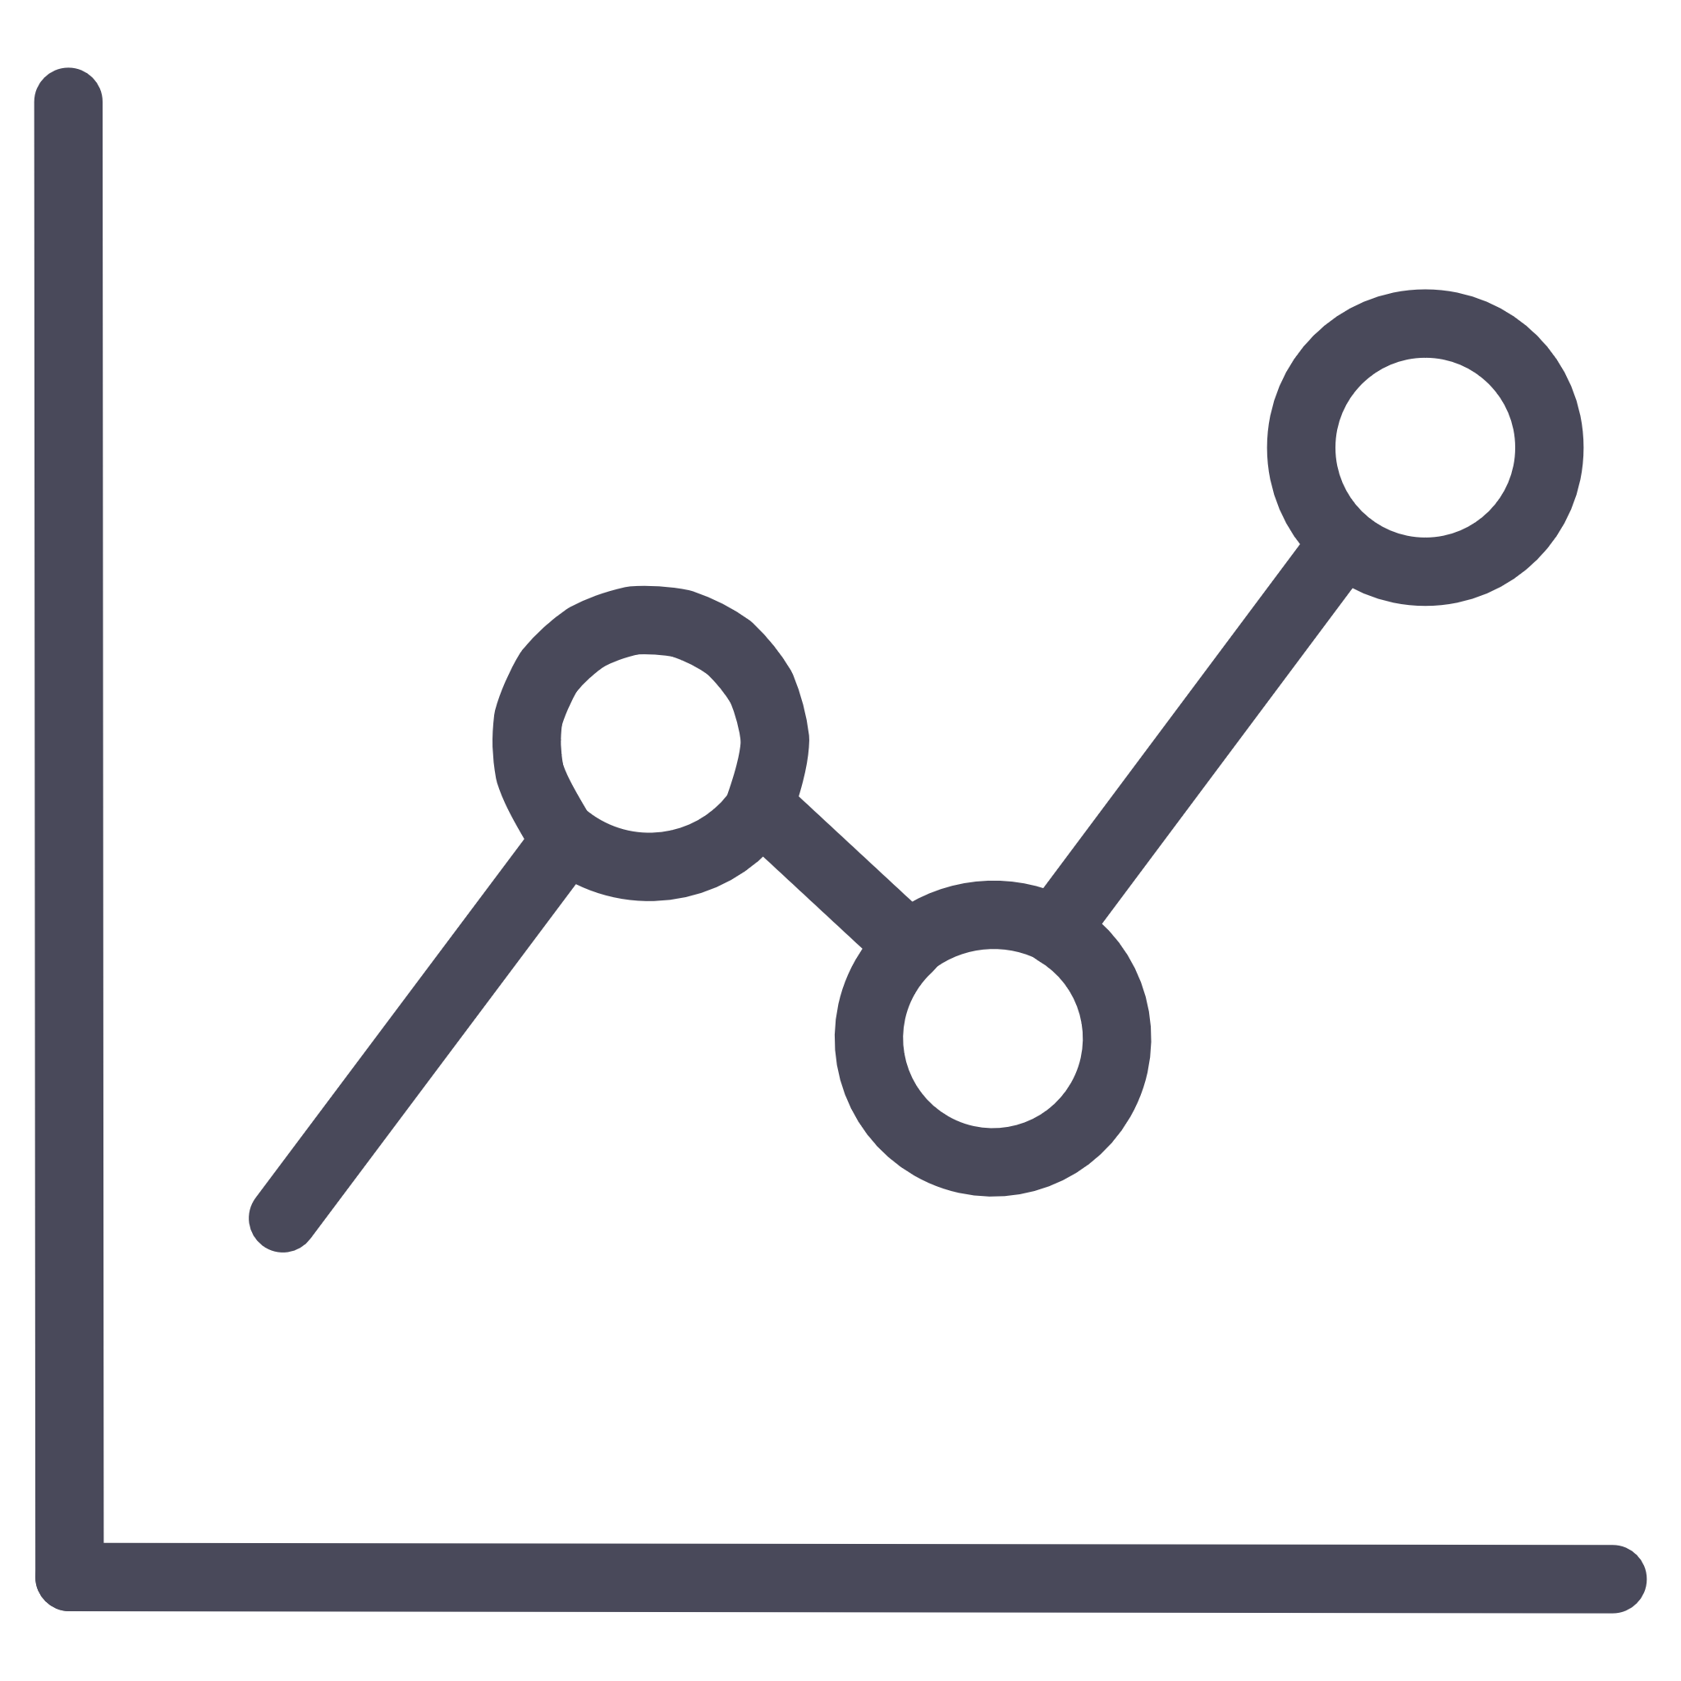


Optimization Methods
Analytical (Calculus-Based)
Uses derivatives to find maxima and minima in simple models with closed-form solutions.
Numerical Optimization
Iterative computation using algorithms for complex systems without analytical solutions.
Genetic Algorithms
Mimics natural selection to find best solutions in bioprocess control and metabolic engineering.
Linear/Nonlinear Programming
Mathematical formulation for constraints in industrial optimization problems.
Machine Learning-Based
AI learns best control strategies for smart agriculture and autonomous systems.

Slide 15
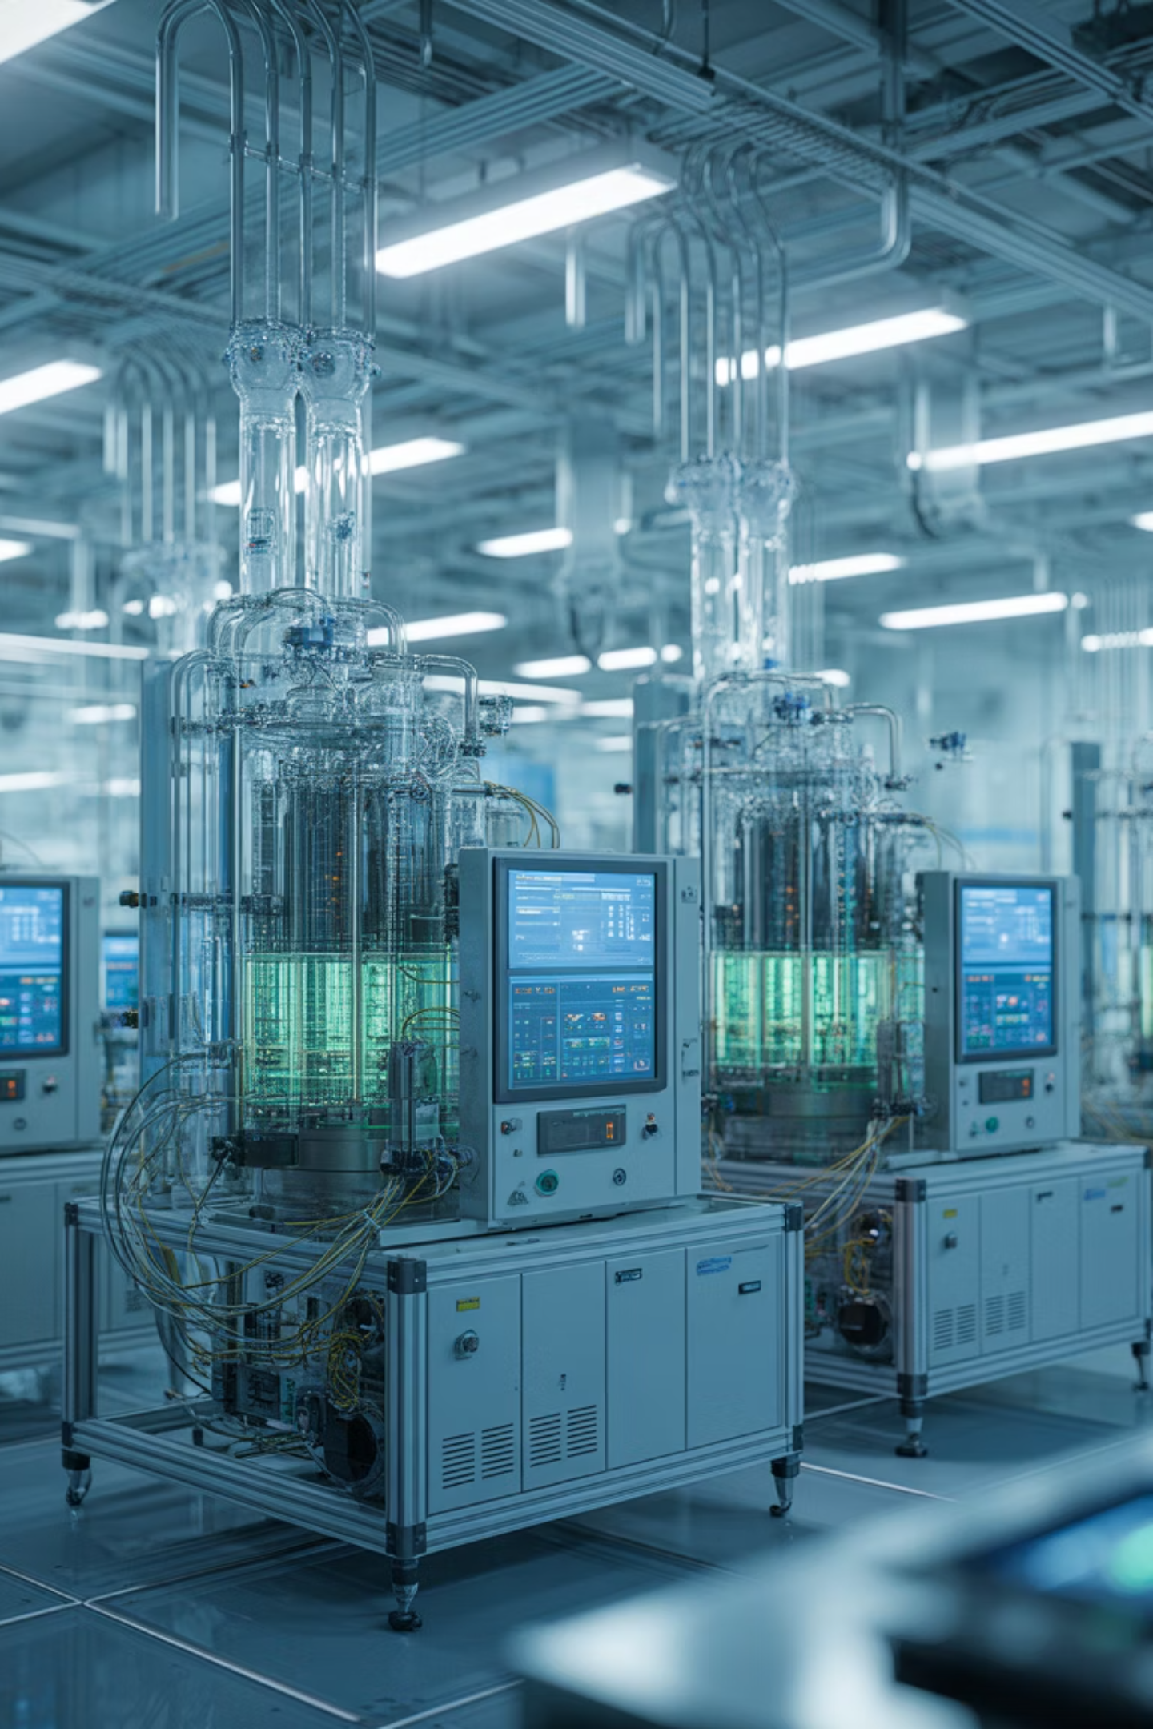
Applications in Biotechnology
1
Bioprocess Control
Maintain pH, temperature, and oxygen levels in fermenters using feedback loops for optimal cell growth and product yield.
2
Metabolic Pathway Optimization
Adjust enzyme concentrations or fluxes to enhance production of metabolites like ethanol and insulin.
3
Drug Delivery Optimization
Predict optimal drug dosage and timing for maximum therapeutic effect with minimal toxicity.
4
Ecological Systems
Control pollutant levels, model population dynamics, and optimize resource use in environmental management.

Slide 16



Stability and Robustness
Two critical properties determine how well systems perform under uncertainty and disturbances.
Stability
Robustness
The ability of a system to return to equilibrium after
experiencing a disturbance or perturbation.
The ability to maintain performance despite uncertainties,
noise, or environmental changes.
Example: A robust metabolic network maintains steady flux despite environmental changes, ensuring consistent cellular function.

Slide 17
Software Tools for System Dynamics
MATLAB / Simulink
COPASI
VENSIM / STELLA
Python (SciPy, Control, Pyomo)
Specialized for biochemical network simulation and metabolic modeling.
Industry-standard for simulation and control analysis with extensive toolboxes.
Visual system dynamics modeling with intuitive graphical interfaces.
Open-source optimization and control simulations with extensive libraries.
Modelica / CellDesigner
Multi-domain system modeling for complex biological and engineering systems.

Slide 18
Real-World Case Studies
Insulin-Glucose Feedback System
Closed-loop model used in artificial pancreas development, maintaining blood glucose levels through continuous
monitoring and insulin delivery.
Bioreactor Optimization
Control of nutrient feed rate and aeration for maximum biomass yield in industrial fermentation processes.
Climate System Models
Feedback loops between CO₂, temperature, and vegetation used for global climate predictions and policy decisions.
Crop Growth Control
Optimize irrigation schedules using system dynamics models of soil-plant-atmosphere interactions for sustainable agriculture.

Slide 19
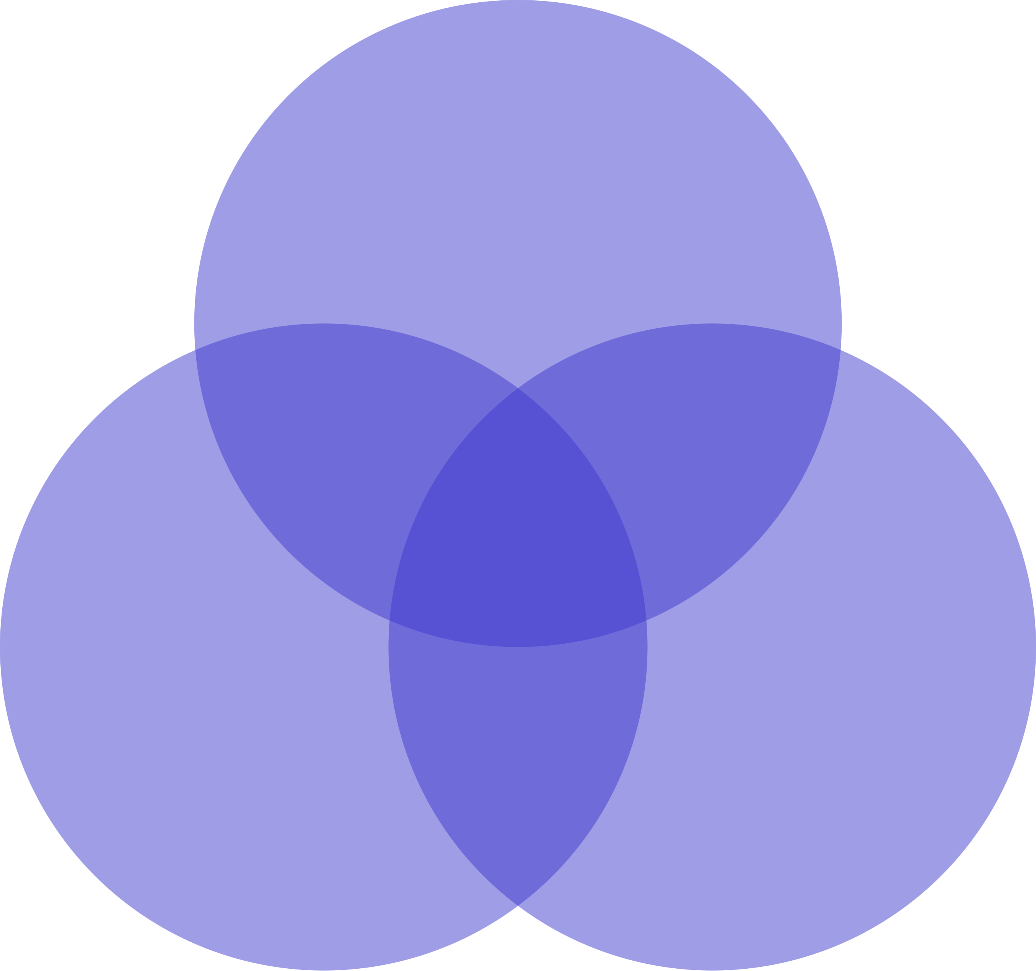
Integration: Dynamics, Control, and Optimization
Optimization
Model‑Based Prediction
Optimal Control
Integrated Design
Stability Analysis
Systems Dynamics
Control Theory
These three disciplines work together synergistically to create powerful solutions across engineering, biotechnology, medicine, and environmental management. Understanding system behavior enables effective control, while optimization ensures peak performance.

Slide 20

Key Takeaways
1
Systems Dynamics
2
Control Theory
Helps understand how systems evolve over time through feedback, delays, and interactions among components.
Ensures system stability and performance through sensors, controllers, and actuators working in feedback loops.
3
Optimization
4
Integrated Approach
Refines system parameters to achieve best results under constraints, balancing multiple objectives.
Together, these approaches are central to modern engineering, biotechnology, medicine, and environmental management.

